Slide 1
Intermolecular Forces (IMF)

Slide 2
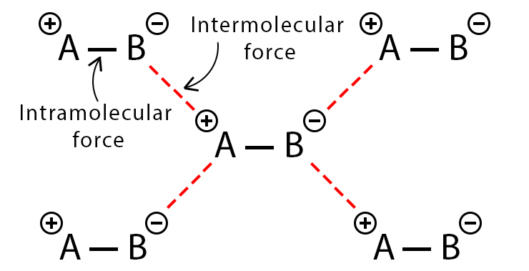
Forces and bonding with molecules is either...
INTRAmolecular
Attraction WITHIN a molecule
Types: Ionic, covalent
INTERmolecular
Attraction BETWEEN molecules
Weaker than intramolecular forces
Types: Ion-Ion, Ion-Dipole, Dipole-Dipole, Hydrogen-Bonding, London Forces

Slide 3
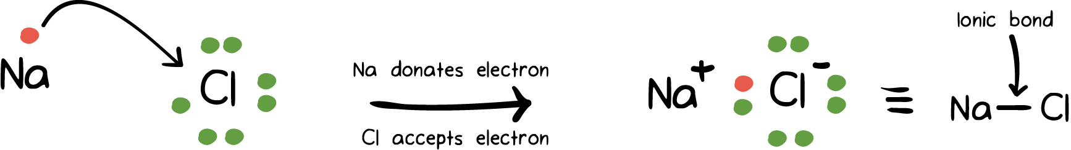
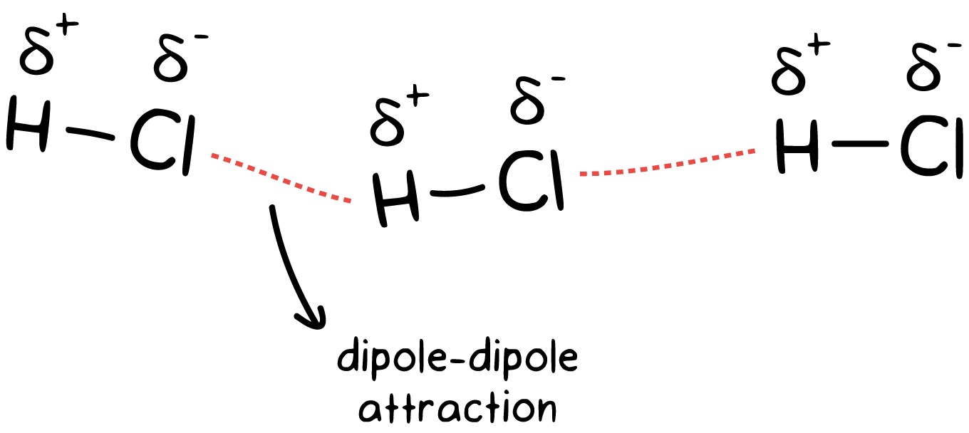
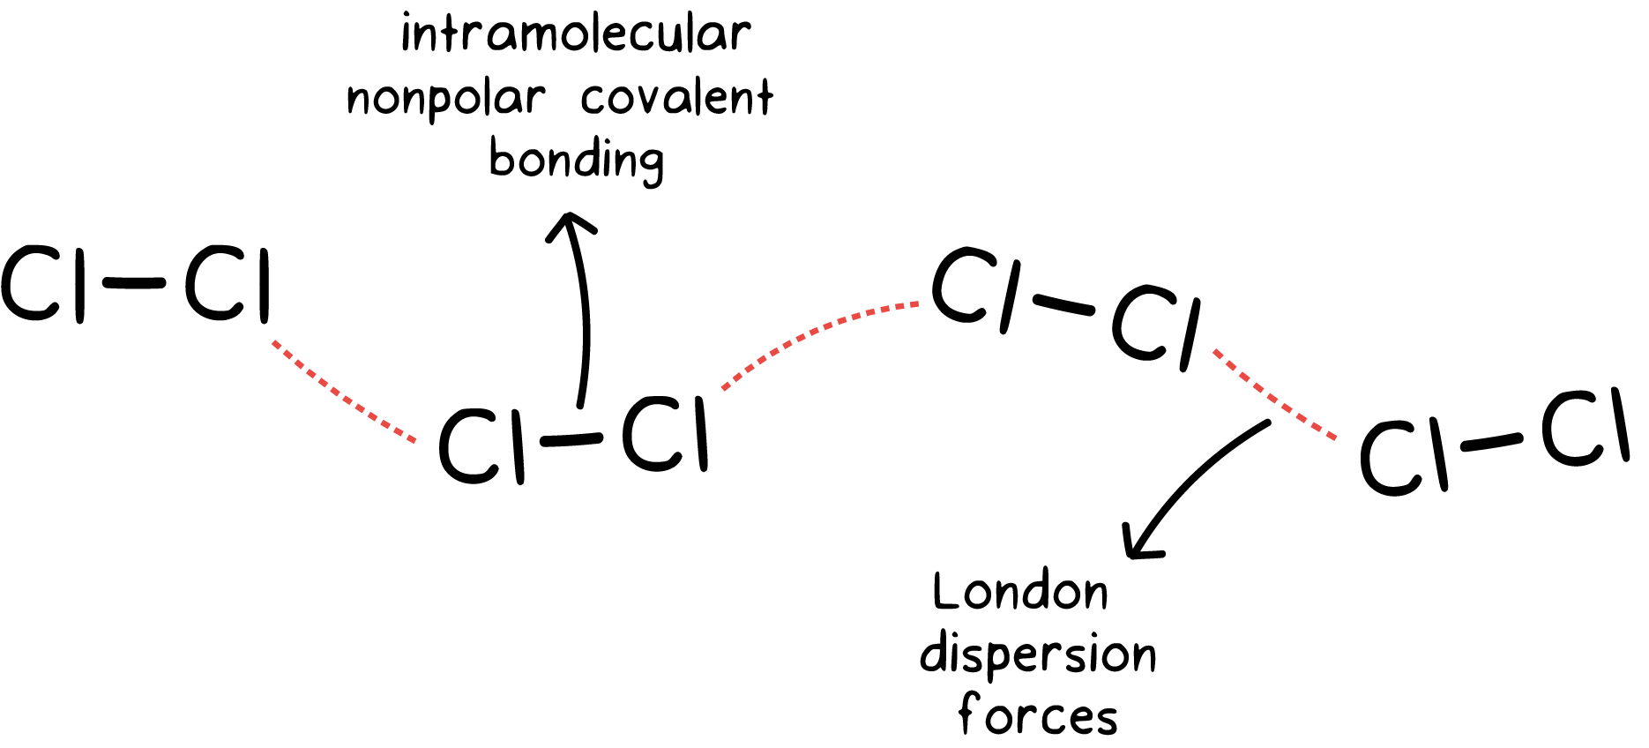
INTERmolecular Forces
Five Major Types
Ion-Ion | (Ionic Compounds)
Ion-Dipole | (Mix of Ionic and Polar)
Dipole-Dipole | (Polar Compounds)
Hydrogen Bonding | (special Dipole-Dipole)
London Forces | (All Compounds)

Slide 4
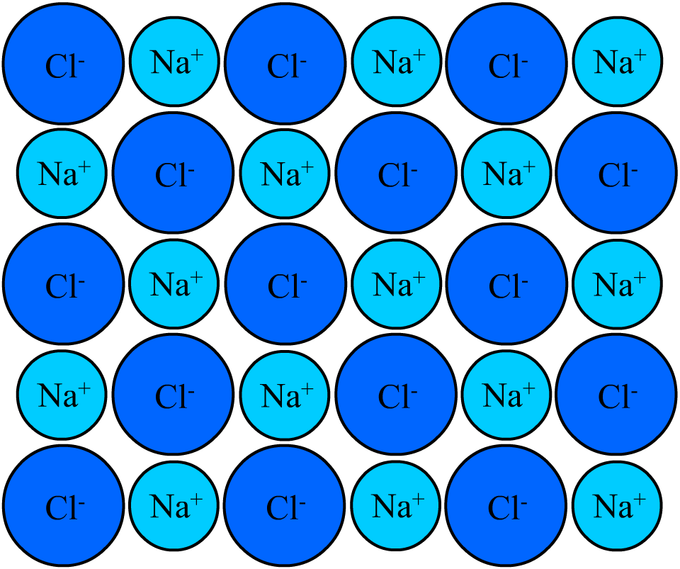
INTERmolecular Forces
Ion-Ion Interactions (Strongest Intermolecular Force)
These are the Ionic Bonds found in ionic crystals
Forces very hard to break, very strong
The strength of an ionic bond is referred to as lattice energy.
Takes a lot of energy (high temperatures) to cause them to split from one another and change states
Strength of the interaction is proportional to the magnitude of the charges and decreases as the distance between the particles increases.
These two factors combined is referred to as charge density

Slide 5
INTERmolecular Forces
Ion-Ion Interactions (Strongest Intermolecular Force)
Consider the following ionic solids:
Can you account for the differences in properties of these 3 ionic solids?
Substance | MP (ºC) | Solubility (g/100g H₂O)
CsCl | 646 | High
NaCl | 800 | Medium
MgO | 2800 | Low (very little)
Both NaCl and CsCl have the same magnitude of charges on their ions.
However, Cs is much larger than Na, making the ionic radius much larger
MgO not only consists of smaller ions, but its ions also have higher charge magnitudes

Slide 6
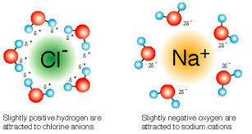
INTERmolecular Forces
Ion-Dipole Interactions (2nd Strongest Intermolecular Force)
Occurs when a fully charged ion interacts with polar molecules (molecules that have a dipole)
Negative end of dipole on polar molecule attracted to a positive ion
Positive end of dipole on polar molecule attracted to a negative ion
Since a dipole is not a FULL charge, this attraction is
not as strong as ion-ion

Slide 7
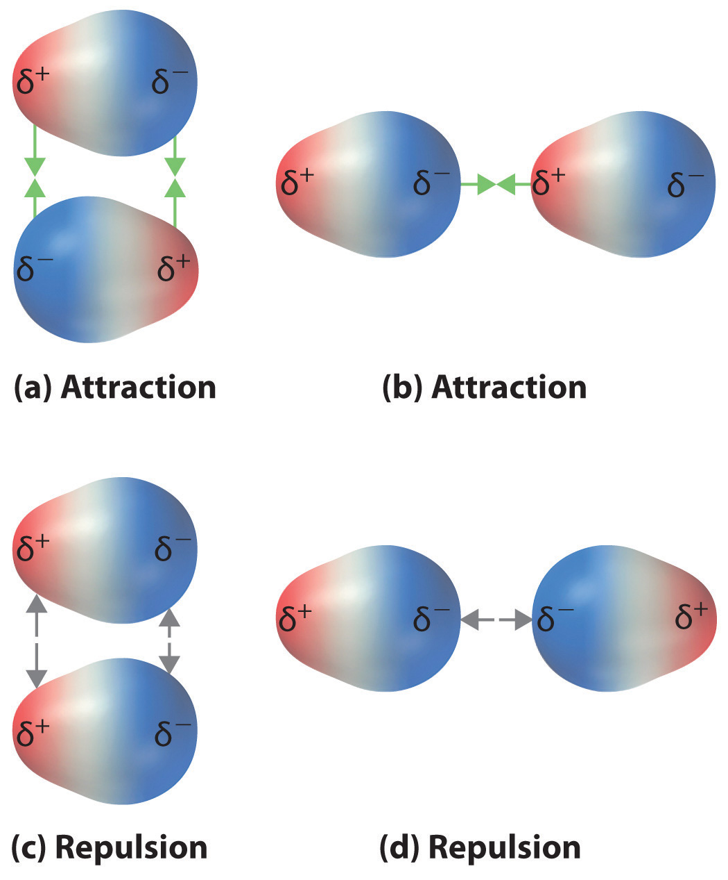
INTERmolecular Forces
Dipole-Dipole Interactions (3rd Strongest IMF)
When molecules have dipoles negative end on one molecule attracted to the positive end of another
This attraction will hold the molecules together, and keep them from separating
There will also be a repulsive force between likely charged sides

Slide 8
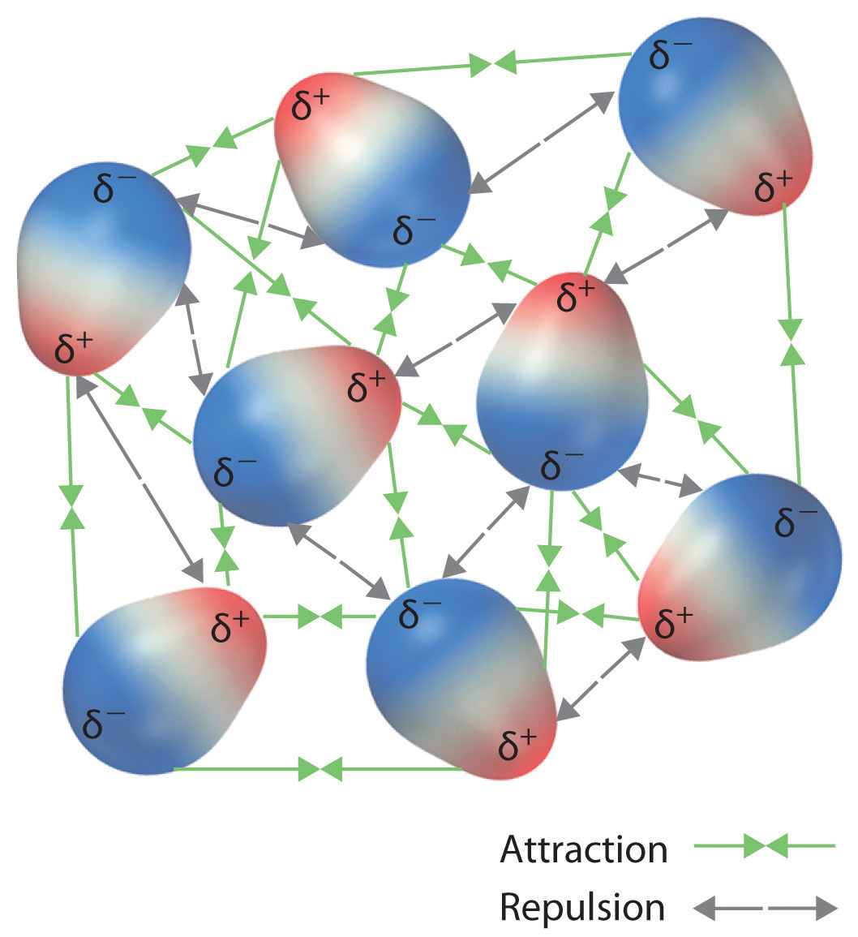
INTERmolecular Forces
Dipole-Dipole Interactions (3rd Strongest IMF)
As they are an electrostatic attraction, the strength of DP-DP interactions are affected by:
1) The distance between both molecules
Molecules that are further apart will experience a weaker attraction to one another
2)The degree of charge separation (ie. how polar are they?)
Molecules with a smaller charge separation will experience a weaker attraction

Slide 9
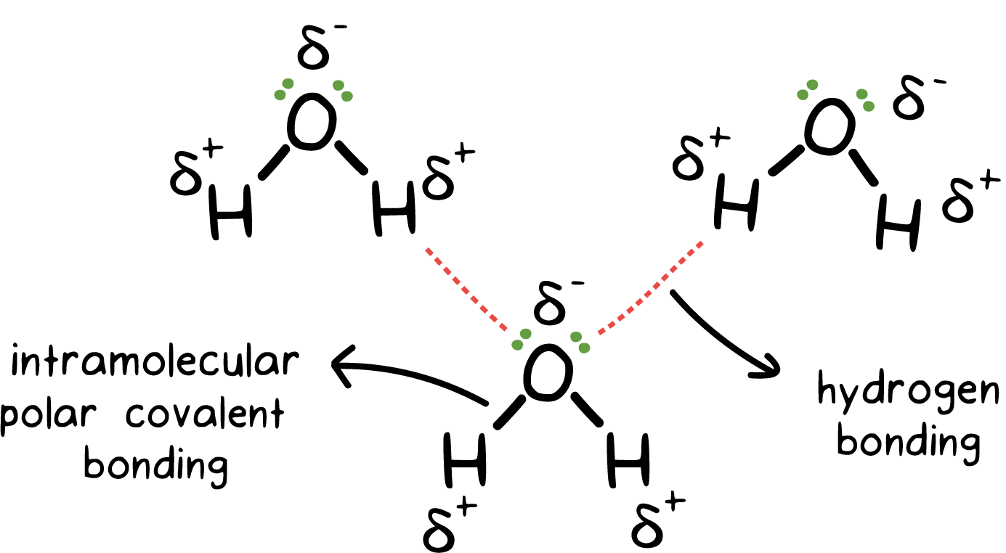
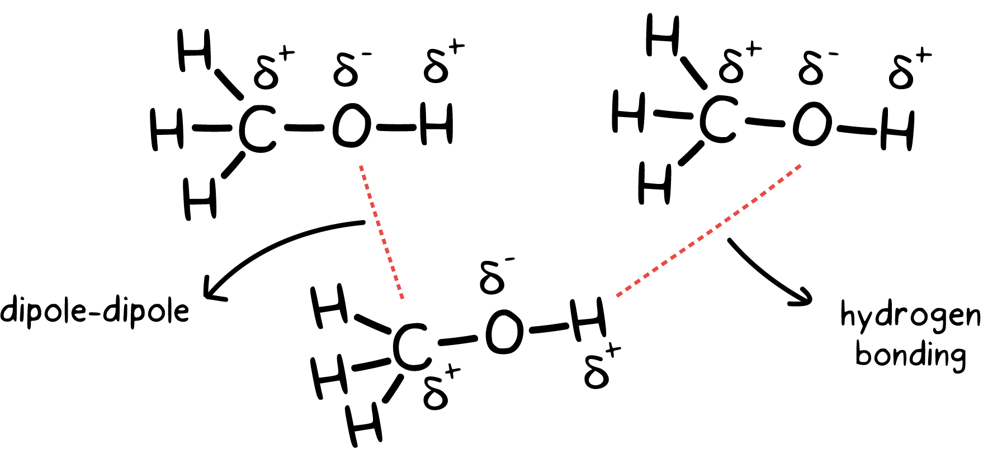
INTERmolecular Forces
Hydrogen Bonding (Strong version of Dipole-Dipole)
When Hydrogen is a part of a dipole with O, F or N, it is a special case of Dipole-Dipole Interaction
Dipole-Dipole but STRONGER than other forms of Dipole-Dipole due to large ΔEN between H and the atom (N,O, or F)
Hydrogen gets a partial positive charge
Hydrogen is small and has no shielding electrons
It will attract to the lone pair of electrons on the electronegative atom of neighboring molecules
This attraction is very strong, and gives these molecules high melting/boiling points
Careful! This only works when Hydrogen is bonded to N, O or F, not every single Hydrogen bond

Slide 10
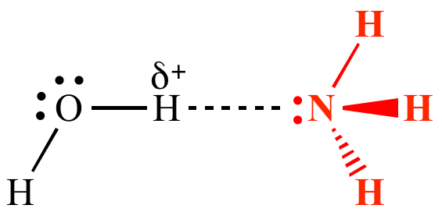
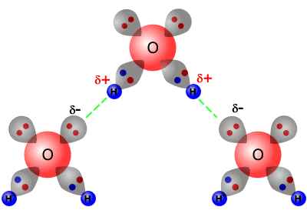
INTERmolecular Forces
Hydrogen Bonding (Strong version of Dipole-Dipole)
Hydrogen bonding is the attraction between a Hydrogen atom (bonded to Oxygen, Nitrogen, Fluorine) and the lone pair on a neighboring atom

Slide 11
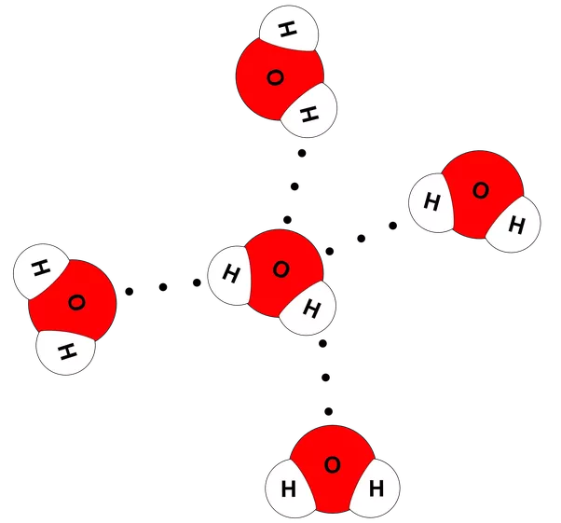
INTERmolecular Forces
Hydrogen Bonding (Strong version of Dipole-Dipole)
Hydrogen Bonding is why water is a liquid at room temperature, not a gas.
Each water molecule can make 4 hydrogen bonds to neighboring water molecules
This arrangement is one reason why ice is less dense than liquid water
Substance | Molar Mass (gmol⁻¹) | Melting Point (ºC)
H₂O | 18.02 | 0
H₂S | 34.1 | -60.1

Slide 12
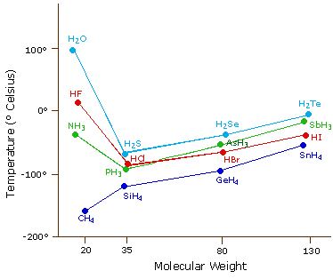
INTERmolecular Forces
Hydrogen Bonding (Strong version of Dipole-Dipole)
H₂O, HF and NH₃ all exhibit Hydrogen Bonding
The hydrogen bond causes the boiling points of molecules with Hydrogen Bonding to be higher than predicted (due to LDF and DP-DP)

Slide 13
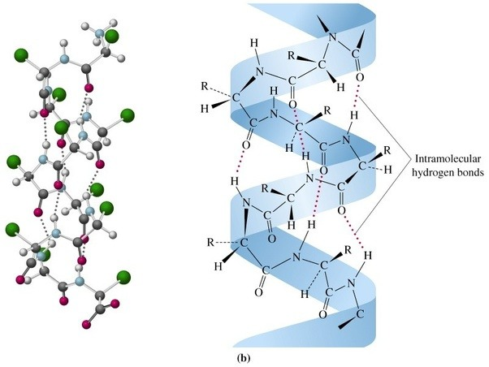
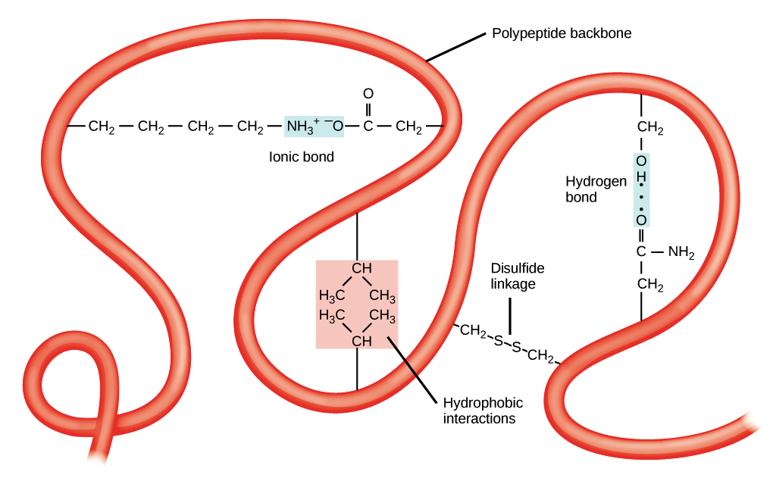
INTERmolecular Forces
Hydrogen Bonding (Strong version of Dipole-Dipole)
This is specifically important for proteins, whose shape is held together by specific angular bonding, which includes hydrogen bonding
This is one of the reasons why DNA spirals!

Slide 14
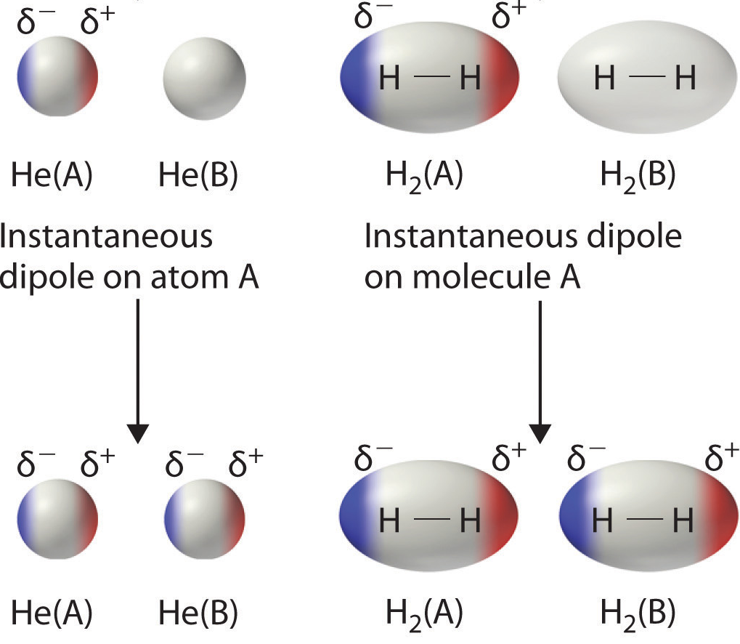
INTERmolecular Forces
London Forces (Weakest Intermolecular Force)
Occur in ALL molecules
Attraction of proton from one molecule to electrons of another molecule due to temporary fluctuations in the electron cloud shifting randomly within atoms and nonpolar molecules result in the formation of short-lived instantaneous dipole moments
Once an instantaneous dipole is formed on a molecule or atom, the partial charges can induce a dipole on neighboring atom or molecules
This induced dipole will be complimentary to the instantaneous dipole, causing an electrostatic attraction to form between both molecules
Notes:
All molecules, whether polar or nonpolar, are attracted to one another by London dispersion forces in addition to any other attractive forces that may be present.
An instantaneous dipole moment on one atom can interact with the electrons in an adjacent atom, pulling them toward the positive end of the instantaneous dipole or repelling them from the negative end:
the net effect is that the first atom causes the temporary formation of a dipole, called an induced dipole, in the second.

Slide 15
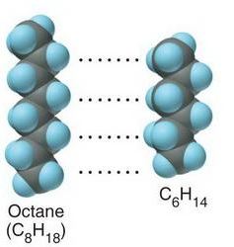
INTERmolecular Forces
London Forces (Weakest Intermolecular Force)
These interactions are SO much weaker than the others, that we only study them in terms of non-polar (pure) covalent molecules
They are overpowered by the other forces
They are dependent on size 🡪 the larger the molecule, the stronger their London Forces, because as they increase in mass, they also increase in number of electrons.
This increases the number that can be temporarily unbalanced to one side, therefore increasing the strength of LDF.
Examples of molecules that only have LDF forces:
Noble Gases (eg. He or Ar) Diatomic elements (eg. H₂ or F₂)
Non-Polar molecules (eg. CO₂ or CH₄)
Notes:
All molecules, whether polar or nonpolar, are attracted to one another by London dispersion forces in addition to any other attractive forces that may be present.
An instantaneous dipole moment on one atom can interact with the electrons in an adjacent atom, pulling them toward the positive end of the instantaneous dipole or repelling them from the negative end:
the net effect is that the first atom causes the temporary formation of a dipole, called an induced dipole, in the second.

Slide 16
INTERmolecular Forces
London Forces (Weakest Intermolecular Force)
Substance | # of electrons | Melting Point (°C) | Boiling Point (°C)
F₂ | 18 | −219.6 | −188.1
Cl₂ | 34 | −101 | −34
Br₂ | 70 | -7.2 | 58.8
I₂ | 106 | 113.7 | 184
As atoms get bigger, more London Dispersion Forces so more attraction between molecules (not atoms within molecule) and therefore higher B.P & M.P.
Substances that only have LDF will generally have very low melting and boiling points
The presence of any other IMF will greatly increase BP
Compare these two data sets for the same group of elements. Where are they on the periodic table? What explains the trend in M.P. & B.P. ?
Note: Surface Area of the molecule/atom also impacts LDF
A larger surface area increases the overlap area for the dipoles
Therefore, a particle with a larger SA will have a higher LDF
Notes:
All molecules, whether polar or nonpolar, are attracted to one another by London dispersion forces in addition to any other attractive forces that may be present.
An instantaneous dipole moment on one atom can interact with the electrons in an adjacent atom, pulling them toward the positive end of the instantaneous dipole or repelling them from the negative end:
the net effect is that the first atom causes the temporary formation of a dipole, called an induced dipole, in the second.

Slide 17
Force | Type of Compound | Example | Rel. Strength
Ion-Ion (Electrostatic) | Ionic | NaCl | Strongest
Ion-Dipole | Ionic and Polar | Salted Water | 2nd Strongest
Hydrogen Bonding | Polar (with H) | NH₃ | Middle (stronger than other Dipole-Dipole)
Dipole-Dipole | Polar Covalent | HCl | Middle
London Forces | All (Non-Polar too) | Cl₂ | Weakest

Slide 18
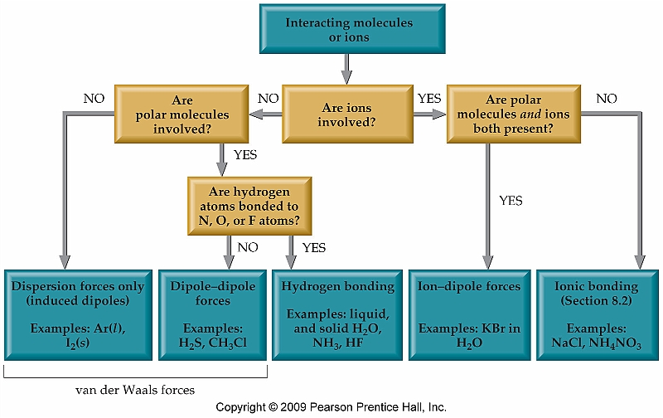
Decision Flow Chart
**London dispersion force is a sub-type of the Van der Waals force that is predominant in non-polar molecules.
-----> Increasing Strength of attractions --->

Slide 19
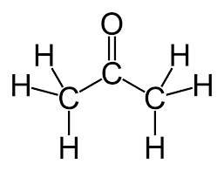

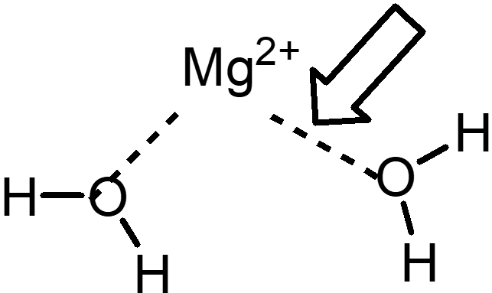
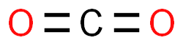
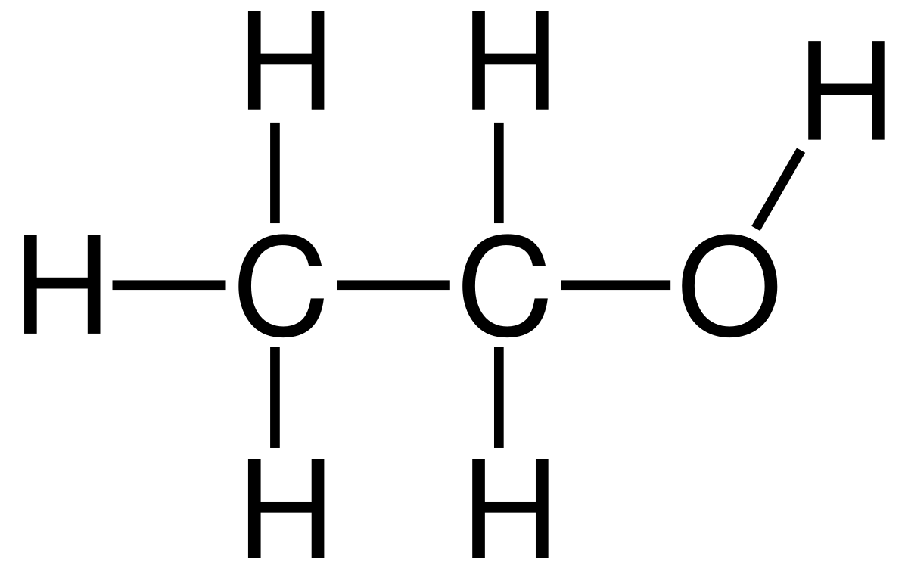
Determine what kind of intermolecular forces exist in the substances below.
Acetone b) Nitrogen Gas c) Dissolved Mg ion
d) Ethanol e) Carbon Dioxide
C=O is polar bond, rest are non-polar so overall molecule is polar
IMF: Dipole-Dipole, London Forces
N=N is non-polar bond so overall molecule is non-polar IMF: London Forces
O-H is a polar bond, Mg²⁺ is ionic
IMF: Ion-Dipole, London Forces
C-H, and C-C are non-polar & O-H is polar
IMF: Hydrogen Bonding, (Dipole-dipole) London Forces
C-O is a polar bond, but the dipoles cancel out
IMF: London Forces

Slide 20
Note!
If you are asked to rank molecules in order of melting point, boiling point, viscosity, surface tension or other affected property, what they are actually asking is for you to rank them by strength of intermolecular forces (either increasing or decreasing)
Thinking Process for answering these:
Look for molecules with hydrogen bonding. They will have the strongest intermolecular forces.
Look for molecules with dipoles. These will have the next strongest intermolecular forces.
Larger molecules will have stronger London dispersion forces. These are the weakest intermolecular forces BUT will often be the deciding factor in multiple choice questions.

Slide 21
Apply the strategy from the yellow slide to the following questions. Write out your thinking!
1. List the following molecules in order of increasing surface tension: C₃H₈, CH₄, CH₃COOH, C₂H₆.
Higher surface tension corresponds to stronger intermolecular forces.
One of these (CH₃COOH) has the ability to hydrogen-bond. It will probably have the strongest intermolecular forces.
CH₃COOH is the only one of these molecules to have a dipole, and we already decided it has the strongest intermolecular forces.
Of the molecules that are left, the largest one (C₃H₈) likely has the strongest London dispersion forces. The smallest (CH₄) likely has the weakest intermolecular forces.
The answer is: CH₄, C₂H₆, C₃H₈, CH₃COOH

Slide 22
Apply the strategy from the yellow slide to the following questions. Write out your thinking!
2. List the following molecules in order of increasing boiling point: Br₂, F₂, I₂, Cl₂.
Higher boiling points will correspond to stronger intermolecular forces.
None of these have hydrogen bonding.
None of these have dipoles.
Bigger molecules will have stronger London dispersion forces. So I₂ has the strongest forces, and F₂ will have the weakest. Correspondingly, I₂ will have the highest boiling point and F₂ will have the lowest boiling point.
Answer: F₂, Cl₂, Br₂, I₂

